Slide 1

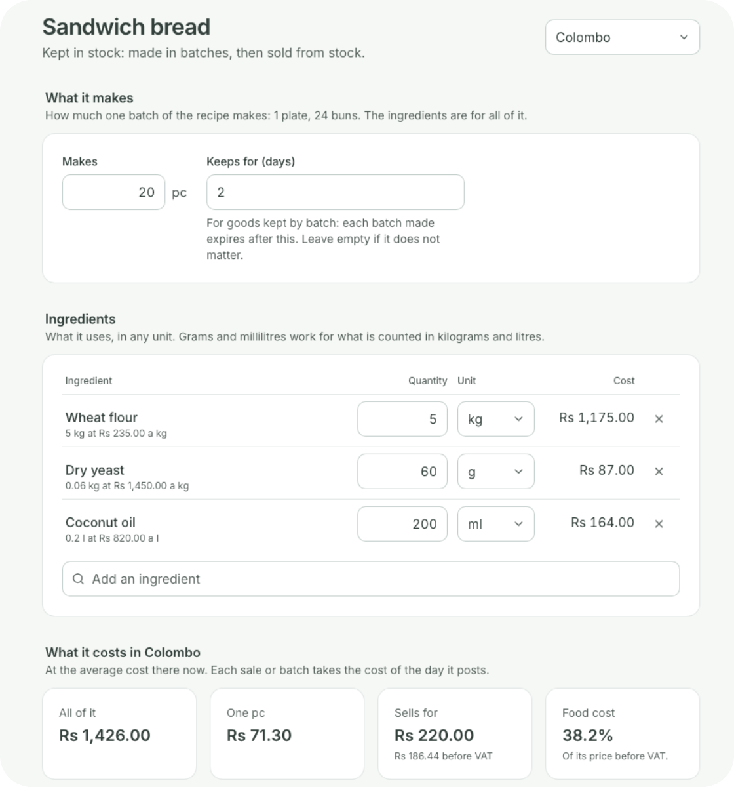

For bakeries
You bake.
Coredile does the rest.
Recipes, the morning bake, what every loaf costs and what’s left at closing,
in one system that keeps selling when the internet drops.
Notes:
Thank you for your time today. I’m going to show you Coredile POS for bakeries. It sells at the counter, of course, but it also knows your recipes, plans the morning bake, tells you what every loaf and cake costs to make, and shows you what was lost and what was left at closing. Please stop me and ask questions at any time.

Slide 2




THE USUAL WAY
Baking is the easy part.
The hard part is knowing what it all costs, and where it went.
Guessing what
each loaf and cake
costs
Flour running out
in the middle of a
bake
Burnt and unsold
bread nobody
writes down
Counting cash and
shelves by hand at
night
Coredile takes care of all of this, every day.
Notes:
Most bakers know how to bake. The hard part is everything around it. Most owners are not sure what one loaf or one cake really costs to make. Flour runs out in the middle of a bake because nobody saw it coming. Burnt trays and bread left over at closing are thrown away, and nobody writes them down, so the losses never show. And at night someone counts the cash and the shelves by hand. Ask them: which of these happens in your bakery?

Slide 3





THE BIG IDEA
One bake. Five jobs done for you.
Stock
Flour, yeast, sugar and oil come off
This morning’s bake
Made
On the shelf
Sandwich bread
57 of 60
223 breads and buns ready to sell
Tea bun
96 of 96
Cost
Fish bun
70 of 72
Each one costs what went into it
Losses
Ingredients
Rs 16,443
5 lost in the oven, counted in rupees
Use by
Bread kept by batch gets its use-by day
Notes:
This is the heart of Coredile for a bakery. In the morning, the baker says what came out of the oven: here, 57 sandwich breads out of 60, all 96 tea buns, and 70 fish buns out of 72. Then Coredile does five jobs by itself. The flour, yeast, sugar and oil come off the stock. The 223 breads and buns go on the shelf, ready for the till. Each one costs exactly what went into it. The 5 that were lost are counted, in rupees. And bread you keep by batch gets its use-by day. Nobody types anything twice. (In Present mode, each job appears one by one as you click.)

Slide 4
RECIPES
Know what every loaf costs you.
Tell Coredile what goes into a batch, once. Kilos,
grams or millilitres.
Sandwich bread, a batch of 20
It works out what one loaf costs, at what you really
paid for the flour.
Wheat flour
5 kg
Rs 1,175
Dry yeast
60 g
Rs 87
Anything at 40% food cost or more is marked, so you
know what to reprice.
Coconut oil
200 ml
Rs 164
One loaf costs
Sells for
Food cost
Change a recipe, and past bakes keep their cost.
Rs 71.30
Rs 220
38%
Food cost is worked out on the price before VAT.
Notes:
Most bakeries guess what a loaf costs. With Coredile, you enter the recipe once: here, a batch of 20 sandwich breads takes 5 kilos of flour, 60 grams of yeast and 200 millilitres of coconut oil. Coredile prices each ingredient at what you actually paid for it, so one loaf costs Rs 71.30 to make, and sells for Rs 220. That is a food cost of 38%. Anything at 40% or more is marked on the list, so you can see straight away what needs a new price. And when you change a recipe, the bakes you made before keep the cost they had.

Slide 5
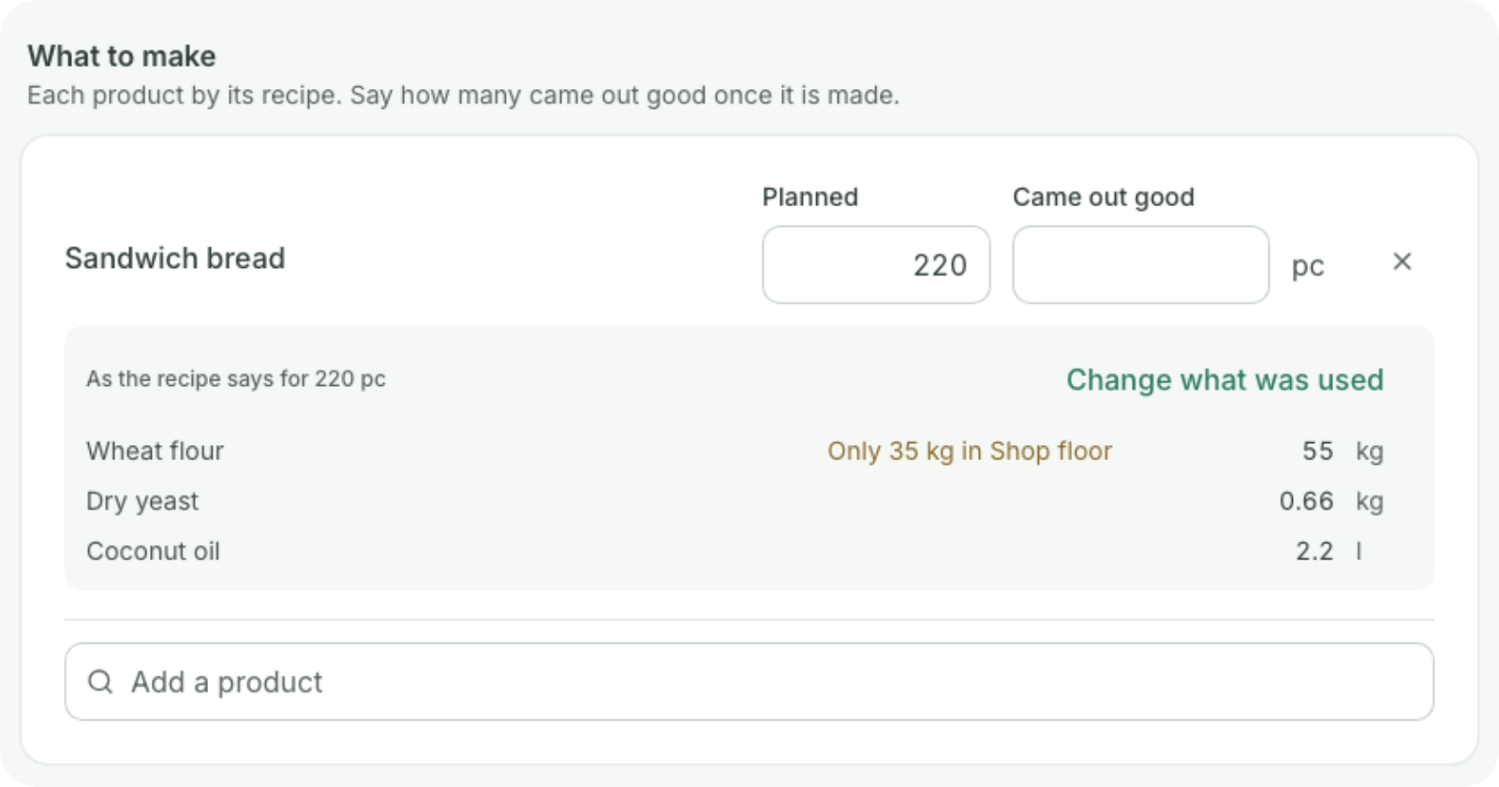
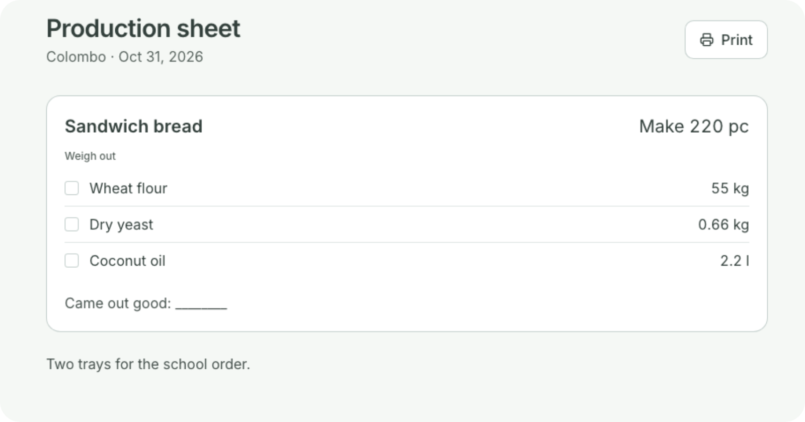

THE NIGHT BEFORE
Plan tomorrow’s bake tonight.
Planned from your recipes,
in any amount
Warns you when there isn’t
enough flour
Print the sheet of what to
weigh out
Add a note, like two trays
for a school
Notes:
The evening before, the manager plans tomorrow’s bake: here, 220 sandwich breads. Coredile works out from the recipe how much flour, yeast and oil that takes, and warns straight away if there isn’t enough flour in stock, so nobody finds out at 4 in the morning. Then you print the production sheet: the baker sees exactly what to weigh out, ticks each line, and writes down how many came out good. You can add a note, like two extra trays for a school order.

Slide 6
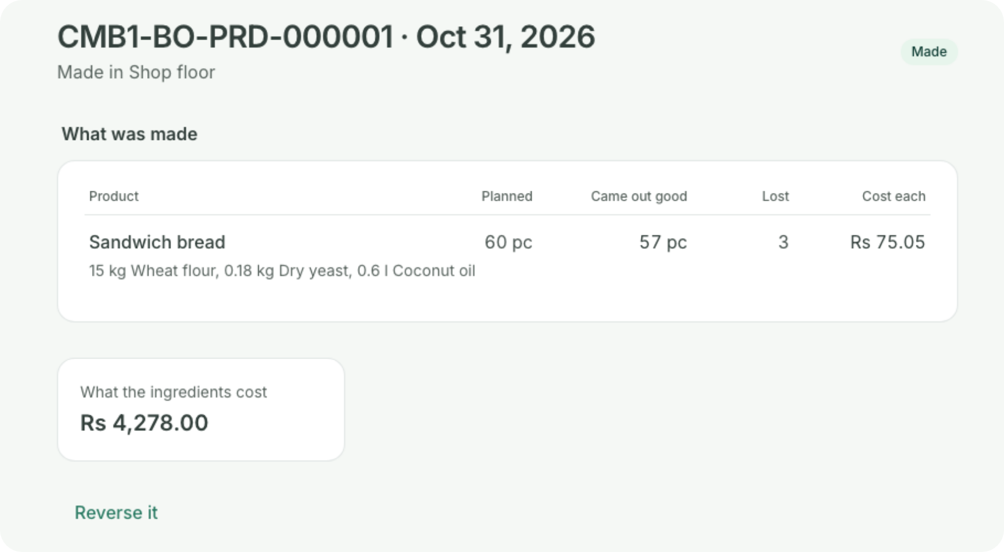

IN THE MORNING
Record what came out good.
The baker says how many came out good
The flour leaves the stock, the bread arrives
Good loaves carry the full cost: Rs 75.05 each
today
Burnt ones are shown, in loaves and in rupees
A mistake can be reversed exactly
Notes:
In the morning, the baker says how many came out good. Here, 60 sandwich breads were planned and 57 came out good; 3 were lost. When it’s saved, the 15 kilos of flour, the yeast and the oil leave the stock, and the 57 loaves arrive on the shelf, ready to sell. The good loaves carry the whole cost of the ingredients, so today each one cost Rs 75.05 instead of Rs 71.30. The 3 lost loaves are shown on the bake and in the production report, in loaves and in rupees. And if someone types the wrong number, the bake can be reversed exactly and entered again.

Slide 7




YOUR RECIPES
Your recipes stay yours.
Bakers can’t open
them
Only you change
them
Every change is
kept
Everyone has
their job
A baker records the bake
without opening your
recipes.
Changing a recipe is a
permission you give, to the
people you choose.
A new version from that
day. Past bakes keep their
cost.
A ready-made Baker role:
record the bake, see stock,
sell.
Notes:
A bakery’s recipes are its secret. In Coredile, a baker can record what came out of the oven without ever opening the recipes. Changing a recipe is a permission you give, only to the people you choose. Every change is kept as a new version from that day, so the bakes you made before keep the cost they had. And there’s a ready-made Baker role: they can record the bake, see the stock and sell at the till, but not change prices or see your money.

Slide 8
WHEN THE INTERNET DROPS
No internet? Keep selling.
Each till keeps its own copy of your products, prices and staff. It does not need the internet to sell.
1
2
3
Internet off
Keep selling
Internet back
The till carries on as if nothing
happened.
Bills print as normal. The
morning rush never notices.
Every bill goes up by itself, in
order. Nothing is lost.
Up to 3 days without internet. At closing, the till tells you if the cash is short or over.
Notes:
Power cuts and internet problems happen, and usually during the morning rush. With most online systems, billing stops and the queue gets longer. Coredile is different. Each till has its own copy of everything it needs. When the internet goes, the cashier keeps billing and printing as normal. When it comes back, every bill is sent up by itself, in the right order. Nothing is lost. A till can work for up to 3 days without internet. And at closing, the cashier counts the cash and the till shows straight away if anything is short or over.

Slide 9
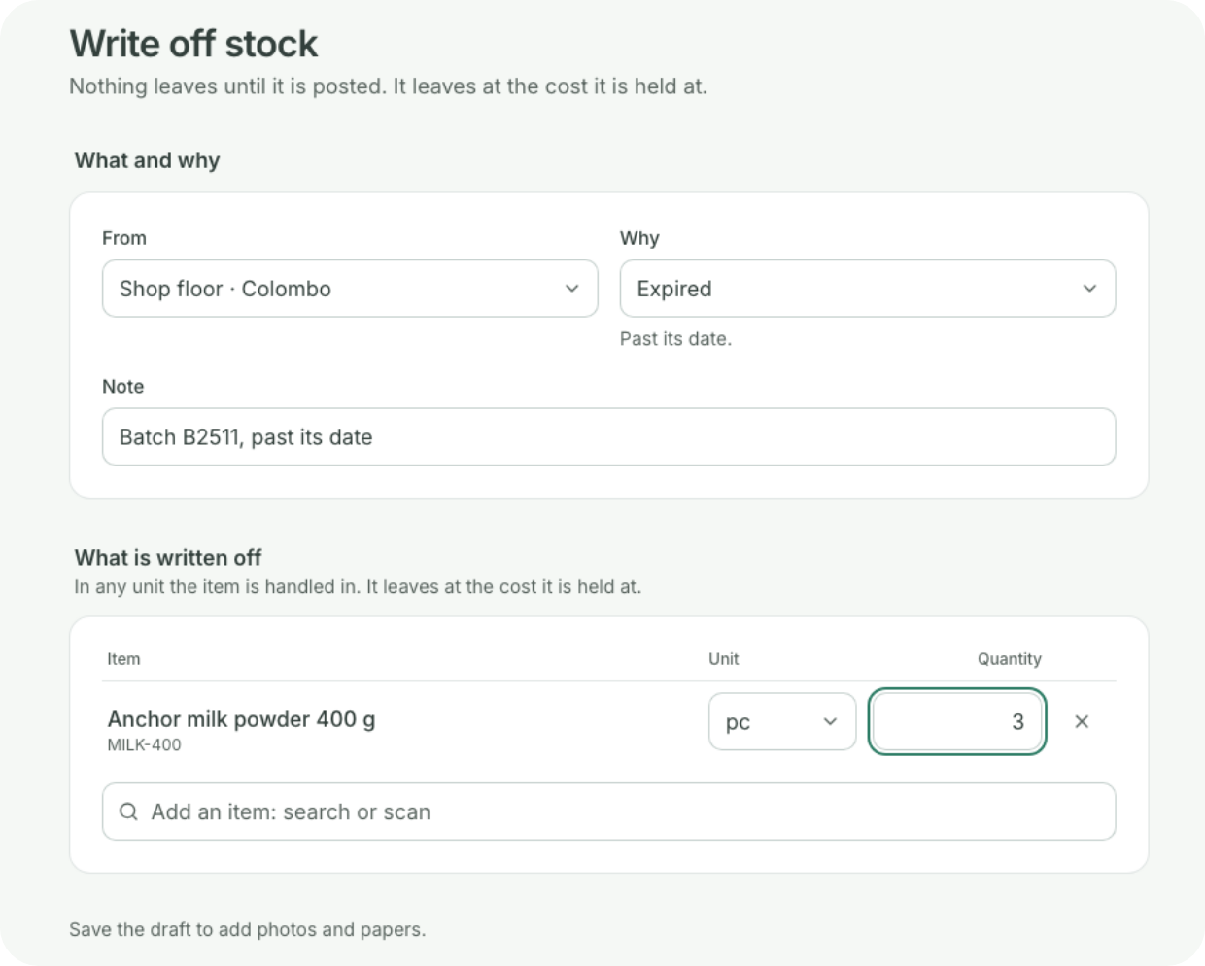

AT CLOSING
Know what’s left at closing.
Write off what didn’t sell, with a reason: expired, spoiled or
damaged
Keep a photo or a note with it, if you want
See what has expired, or will soon
Evening deals by the hour, with Offers and Loyalty
Notes:
At the end of the day, what didn’t sell is written off with a reason: expired, spoiled or damaged. You can keep a photo or a note with it. So the losses are on record, in rupees, instead of going in the bin without a trace. For anything you keep by batch, Coredile shows what has expired and what will expire soon. And with Offers and Loyalty, you can set evening deals by the hour, like three buns for a lower price after six, and every till applies them by itself.

Slide 10
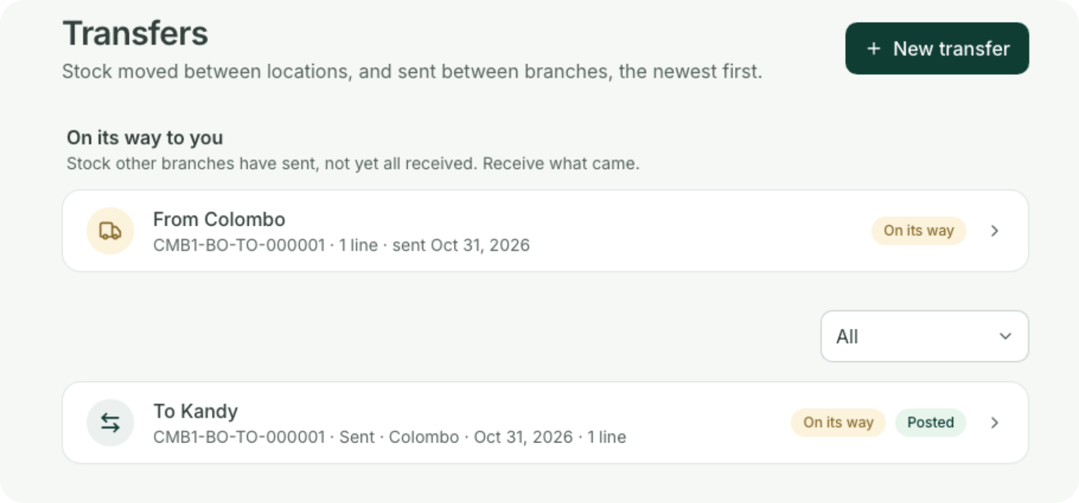




MORE THAN ONE SHOP
One bakery, many shops.
Send bread from the bakery to each shop
Each shop receives what actually came
See what’s on its way, and what never arrived
Each shop’s stock and sales, on their own
Notes:
Many bakeries bake in one place and sell in several shops. With Coredile, the bakery sends the bread to each shop, and the shop receives what actually arrived. If a tray is missing, both sides see it: what’s still on its way and what never came. Every shop has its own stock and its own sales, and the owner sees them side by side.

Slide 11
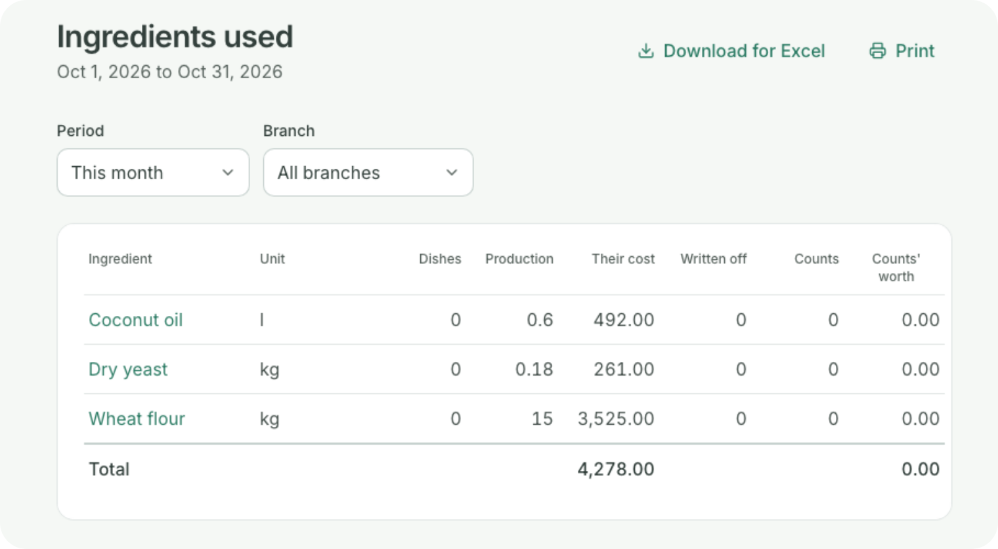




FOR THE OWNER
See where the flour goes.
Each day’s bake: planned, good and lost
Ingredients used, against what the counts found
Recipe costs, the highest food cost first
Yesterday’s sales in a 7 a.m. email, shop by shop
Notes:
The owner sees where every kilo of flour went. The production report shows each day’s bake: what was planned, what came out good and what was lost, and what one good item cost. The ingredients report puts what the recipes used next to what the counts found, so missing flour or sugar shows up. The recipe costs report lists every product with the highest food cost first. And every morning at 7, an email arrives with yesterday’s sales, shop by shop.

Slide 12


STOCK AND ACCOUNTS
The books keep themselves.
Stock
Accounts
Ingredients come off with every bake
Profit and loss, for any month
See what’s running low before it runs out
What you owe each supplier
Order from suppliers, and check what arrives
A VAT and SSCL summary each month
Count the store room and see what went missing
Any report downloads for Excel
Notes:
No more counting the store room by hand every week. Every bake takes its flour, sugar and yeast off the stock by itself. You see what’s running low before it runs out, order from your suppliers, and check what actually arrives. When you do count, Coredile shows you what went missing. On the accounts side, every bill, delivery and write-off goes into the books as it happens. So at any time you can see your profit and loss and what you owe your suppliers, and every month there’s a VAT and SSCL summary for your accountant. Any report can be downloaded for Excel.

Slide 13
WHAT CHANGES
Your day, before and after.
Without Coredile
With Coredile
Food cost
A guess
Known for every item
The bake
In the baker’s head
Planned and printed
Burnt bread
Never written down
Counted in rupees
Unsold at closing
Thrown away, unrecorded
Written off with a reason
Internet down
Billing stops
Selling carries on
The owner
Phones each shop
Gets one email at 7 a.m.
Notes:
Here is the simple picture. Without Coredile, food cost is a guess, the bake is planned in the baker’s head, burnt bread is never written down, what doesn’t sell is thrown away without a record, billing stops when the internet goes down, and the owner has to phone each shop. With Coredile, all of that happens by itself while you bake and sell. You save time every day, and you stop losing money you can’t see.

Slide 14
PRICE
One price per branch.
No charge per cashier, per product or per bill.
Bakery
Extra till
Rs 1,500 a month
Rs 6,500
a month per branch, with two tills
Offers and Loyalty, if you want it
Rs 2,000 a month
Recipes and food cost
Bake plans and printed sheets
Losses and use-by dates
Stock, suppliers and transfers
Pay yearly
Quick counter billing
Accounts and every report
2 months free
Setup and training are agreed with you, in writing, before we start. Prices in Sri Lankan rupees; VAT is added if it applies.
Notes:
Our price is simple. A bakery pays one price per branch, per month: Rs 6,500. That includes two tills, recipes and food cost, the bake plans and printed sheets, losses and use-by dates, stock, suppliers and transfers between shops, and the accounts and every report. There is no extra charge for more cashiers, more products or more bills. If you need a third till, it is Rs 1,500 a month. Offers and Loyalty, for evening deals, points and gift cards, is Rs 2,000 a month per branch, only if you want it. If you pay for a year, you get 2 months free. Setup and training depend on your bakery, and we agree that price with you in writing before anything starts.

Slide 15
WHAT YOU NEED
Simple to start.
You bring
We do
A Windows PC or laptop for each till
Load your products and recipes, from Excel or
your recipe book
A receipt printer at each till
Set up your bakery and your shops
Any printer for the bake sheet
Train your cashiers and bakers
A cash drawer, if you want one
Answer when you call us for help
No hardware yet? We’ll give you a price for all of it.
You check everything before you start selling.
Notes:
Getting started is easy. You need a Windows PC or laptop for each till, and a receipt printer. For the bake sheet, any ordinary printer will do. A cash drawer is up to you. If you don’t have the hardware yet, we can give you a price for all of it. We do the hard part: we load your products and recipes, from an Excel sheet or even your recipe book, set up your bakery and your shops, and train your cashiers and bakers. And when you need help, you call us.

Slide 16

GETTING STARTED
Four simple steps.
1
2
3
4
Free demo
Agree the price
We set it up
Start selling
We show you Coredile with
breads and cakes like yours.
You get the setup and training
price in writing.
We load your products and
recipes, set up your tills and
train your staff.
Pay by the month or by the
year.
No long contract. You pay month by month, or pay for 10 months and use it for 12.
Notes:
Here is how we start. First, a free demo, like today, with breads and cakes like yours. Second, we agree the setup and training price, and you get it in writing. Third, we come and set everything up: we load your products and recipes, set up your tills and train your cashiers and bakers. Fourth, you start selling. There is no long contract. You pay month by month, or pay for a year and get 2 months free. The tills start billing once the first invoice is paid, and each invoice is emailed to you 10 days before it’s due.

Slide 17




WHO MAKES IT
Built in Sri Lanka,
by people you can call.
Your data is backed up every day
8
80+
No other business can ever see your data
Updates come to you, at no extra cost
years building software for
businesses
projects delivered
Help from the people who built it
Notes:
Coredile POS is made by Coredile, a Sri Lankan software company. We have spent 8 years building software for businesses, and delivered more than 80 projects. Your data is backed up every day, and no other business can ever see it. Updates come to you at no extra cost. And when you need help, you talk to the people who actually built the system, not a call centre.

Slide 18

NEXT STEP
Book your free demo.
We’ll show you Coredile with breads and cakes like yours. Bring all your questions.
EMAIL
WEBSITE
WHATSAPP
hello@coredile.com
coredilepos.cloud
+94 72 282 2060
Notes:
Thank you. The best way to see if Coredile is right for you is a free demo with breads and cakes like yours. We can do it at your bakery, or here. Ask: when is a good day for you this week? Leave the contact details with them, and write down how many shops and tills they have, and what they bake, so the demo is ready for them.

